Slide 1
COLUMNS AND STRUTS
By Dr. Andoh

Slide 2
COLUMNS AND STRUTS
.
 | Learning Objectives After reading this unit you should be able to: Define a strut Derive the Euler’s critical load equations for the various ended-joints Compute the critical load using the Euler’s load formulae Derive the equation of critical load using the other methods Compute the critical load using the other methods

Slide 3
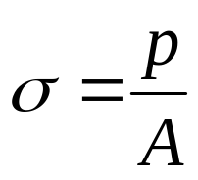
EULER CRIPPLING LOAD FORMULA
Definition of Strut
A structural member, subjected to an axial compressive force, is called a strut. As per definition, a strut may be horizontal, inclined or even vertical. But a vertical strut, used in buildings or frames is called a column.
It has been observed, that when a column or a strut is subjected to some compressive force, then the compressive stress induced,
where P Compressive force and
A Cross-sectional area of the column

Slide 4
A little consideration will show that if the force or load is gradually increased the column will reach a stage, when it will be subjected to the ultimate crushing stress. Beyond this stage, the column will fail by crushing. The load corresponding to the crushing stress, is called crushing load.
It has also been experienced that sometimes, a compression member does not fail entirely by crushing, but also by bending i.e., buckling. This happens in the case of long columns. It has also been observed that all the short columns fail due to their crushing. But, if a long column is subjected to a compressive load, it is subjected to a compressive stress. If the load is gradually increased, the column will reach a stage, when it will start buckling.
The load at which the column just buckles is called buckling load, critical load or crippling load and the column is said to have developed an elastic instability. A little consideration will show that for a long column, the value of buckling load will be less than the crushing load. Moreover, the value of buckling load is low for long columns and relatively high for short columns.

Slide 5
Euler's Column Theory
The first rational attempt, to study the stability of long columns, was made by Mr. Euler. He derived an equation, for the buckling load of long columns based on the bending stress. While deriving this equation, the effect of direct stress is neglected. This may be justified with the statement that the direct stress induced in a long column is negligible as compared to the bending stress. It may be noted that the Euler's formula cannot be used in the case of short columns, because the direct stress is considerable and hence cannot be neglected.
Assumptions in the Euler's Column Theory
The following simplifying assumptions are made in the Euler's column theory:
Initially the column is perfectly straight and the load applied is truly axial.
The cross-section of the column is uniform throughout its length.
The column material is perfectly elastic, homogeneous and isotropic and thus obeys Hooke’s law
The length of column is very large as compared to its cross-sectional dimensions.
The shortening of column, due to direct compression (being very small) is neglected.
The failure of column occurs due to buckling alone

Slide 6
Types of End Conditions of Columns
In actual practice, there are a number of end conditions, for columns. But, we shall study the
Euler's column theory on the following four types of end conditions, which are important from the subject point of view:
Both ends hinged.
Both ends fixed,
One end is fixed and the other hinged, and
One end is fixed and the other free.
Now we shall discuss the value of critical load for all the above mentioned type of and conditions of columns one by one.

Slide 7
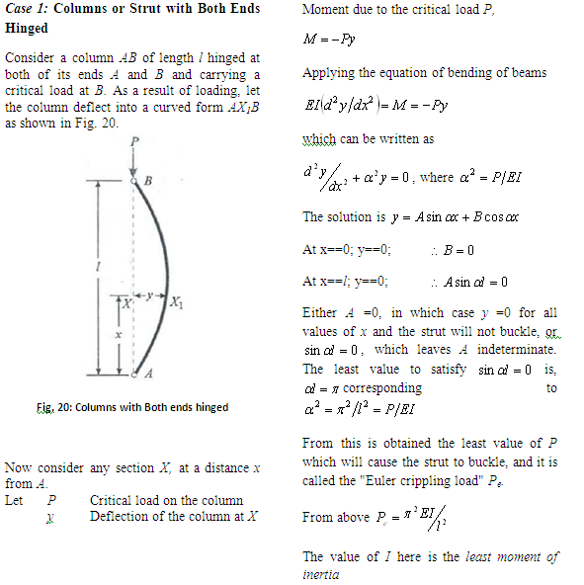

Slide 8
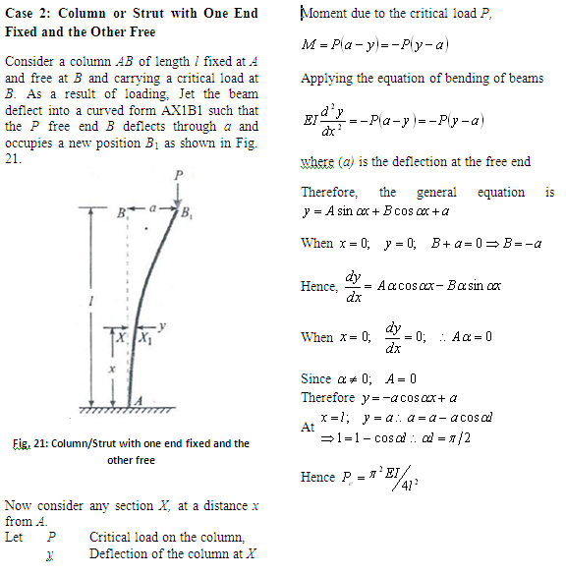

Slide 9
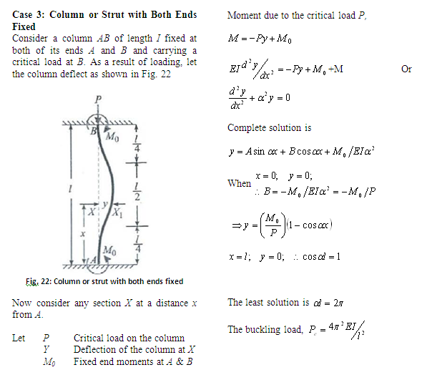

Slide 10
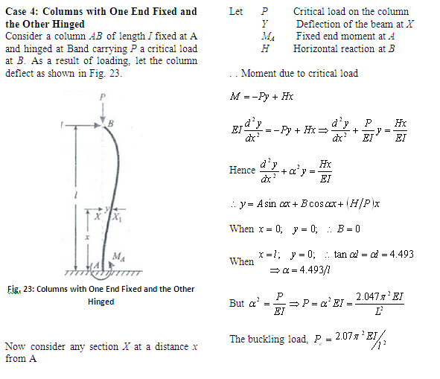

Slide 11
Euler's Formula and Equivalent length of a Column
In the previous articles, we have derived the relations for the crippling load under various end conditions. Sometimes, all these cases are represented by a general equation called Euler 's formula
where L_{e} is the equivalent or effective length of column.
There is another way of representing the equation for the crippling load by an equivalent length of effective length of a column. The equivalent length of a given column with given end conditions, is the length of an equivalent column of the same material and cross-section with both ends hinged and having the value of the crippling load equal to that of the given column.
The equivalent lengths (L) for the given end conditions are given below:

Slide 12
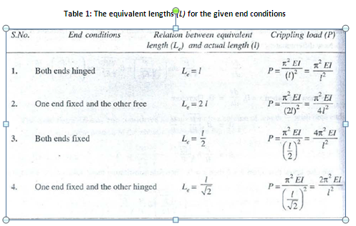
NOTE: The vertical column will have two moment~ of inertia (viz; I_{xx} and I_{yy}). Since the column will tend to buckle in the direction of least moment of inertia, therefore the least value of the two moments of inert in
is to be used in the relation.

Slide 13
Slenderness Ratio
We have already discussed above that, the Euler’s formula for the crippling load is . .. (i)
We know that the buckling of a column under the crippling load will take place about the axis of least resistance. Now substituting I = Ak² (where A is the area and k is the least radius of gyration of the section) in the above equation, … (ii)
where is known as slenderness ratio. Thus slenderness ratio is defined as ratio of equivalent (or unsupported) length of column to the least radius of gyration of the section. Slenderness ratio does not have any units.
Note: It may be noted that the formula for crippling load, in the pervious articles, have been derived on the assumption that, the slenderness ratio is so large, that the failure of the column occurs only due to bending, the effect of direct stress (i.e., ) being negligible.

Slide 14
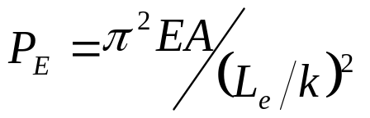
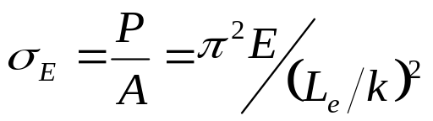
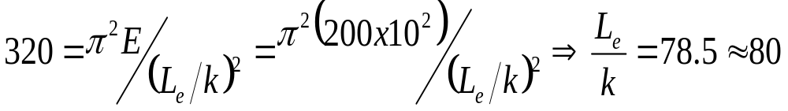
Limitation of Euler's Formula
We have discussed above that the Euler·s formula for the crippling load is
Therefore, Euler's crippling stress,
A little consideration will show that the crippling stress will be high, when the slenderness ratio is small.
We know that the crippling stress for a column cannot be more than the crushing stress of the column material It is thus obvious that the Euler's formula will give the value of crippling stress of the column (equal to the crushing stress of the column material) corresponding to the slenderness ratio. Now consider a mild steel column. We know that the crushing stress for the mild steel is 320 MPa or 320 N/mm² and Young's modulus for the mild steel of 200 GPa or 200 x I 0 N/mm².
Now equating the crippling stress to the crushing stress,

Slide 15
Thus, if the slenderness ratio is less than 80 the Euler's formula for a mild steel column is not valid.
Sometimes, the columns, whose slenderness ratio is more than 80 are known as long column and those whose slenderness ratio is less than 80 are known as short columns. It is obvious that, the Euler’s formula holds good only for long columns.

Slide 16
Example:
A straight bar of alloy, 1 m long and 12·5 mm by 4·8 mm in section, is mounted in a strut-testing machine and loaded axially until it buckles. Assuming the Euler formula to apply, estimate the maximum central deflection before the material attains its yield point of 280 N/mm². E = 72,000 N/mm².

Slide 17
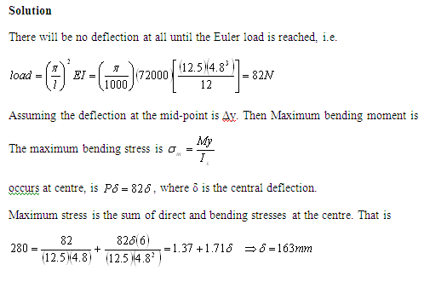

Slide 18
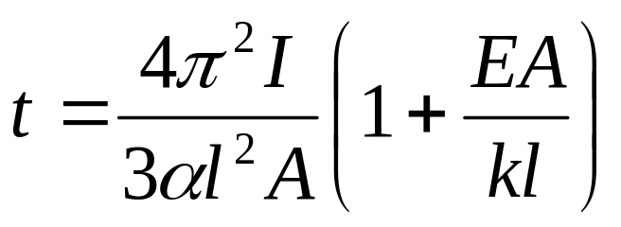
Example 2
A uniform bar of cross-sectional area A and flexural stiffness EI is heated so that its temperature varies linearly from ½t at one end to t at the other end. One end is pin-jointed to a rigid foundation; the other end is pin-jointed so that it can slide in the direction of the length of the bar, the thermal expansion of which is resisted by a compression spring of stiffness k.
If there is no load in the spring when t =0, obtain an expression for the stress in the bar when it is heated and show that it buckles in flexure when
, where α=coefficient of linear thermal expansion.

Slide 19
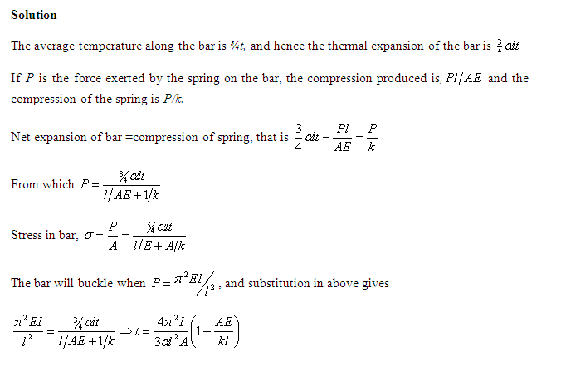

Slide 20
Example 3:
A steel rod 5 m long and of 40 mm diameter is used as a column, with one end fixed and the other free. Determine the crippling load by Euler's formula. Take E as 200 GPa

Slide 21
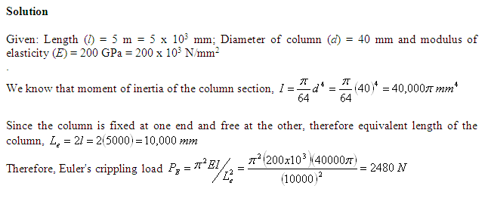

Slide 22
Example 4:
A hollow alloy tube 4 m long with external and internal diameters of 40 mm and 25 mm respectively was found to extend 4.8 mm under a tensile load of 60 kN. Find the buckling load for the tube with both ends pinned. Also find the safe load on the tube, taking a factor of safety as 5.

Slide 23
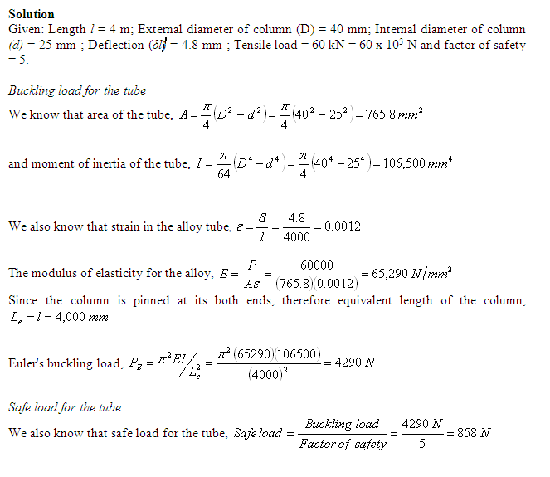

Slide 24
Example 5:
An I section joist 400 mm x 200 mm x 20 mm and 6m long is used as a strut with both ends fixed as shown in Fig. 24. What is Euler's crippling load for the column? Take Young's modulus for the joist as 200 GPa.

Slide 25
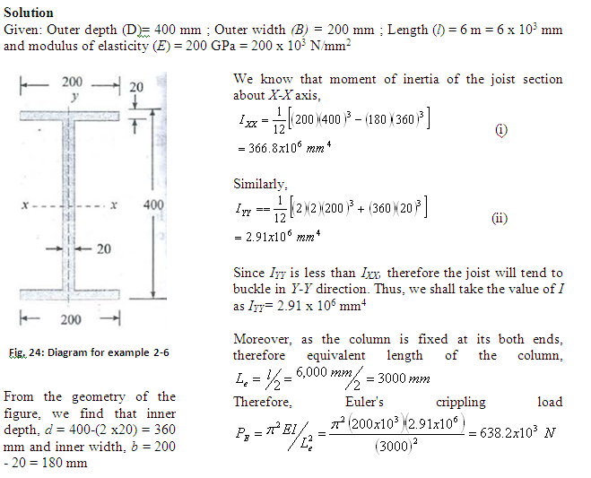

Slide 26
Example 6:
A T-section 50 mm x 120 mm x 20 mm is used as a strut of 4 m long with hinged at its both ends. Calculate the crippling load, if Young's modulus for the material is 200 GPa.

Slide 27
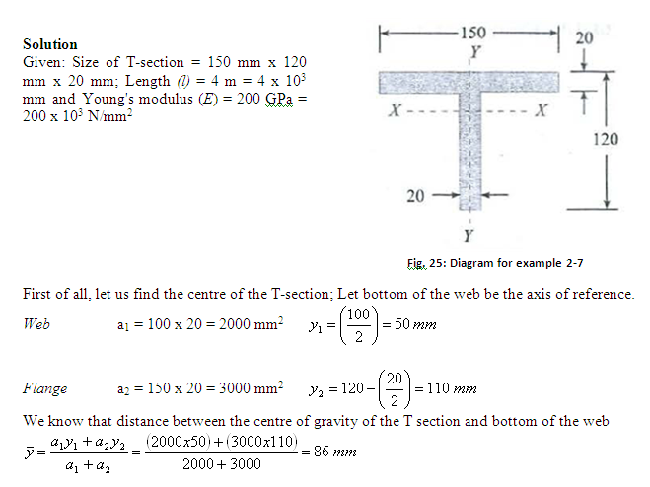

Slide 28
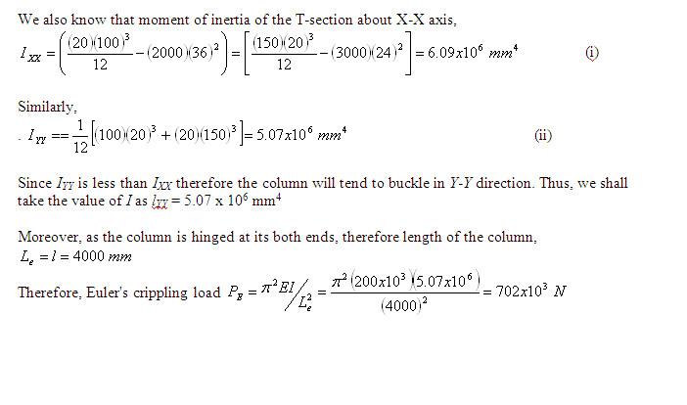

Slide 29
Self Assessment
Derive the equation of the critical load using Euler formula for cases 3 and 4

Slide 30
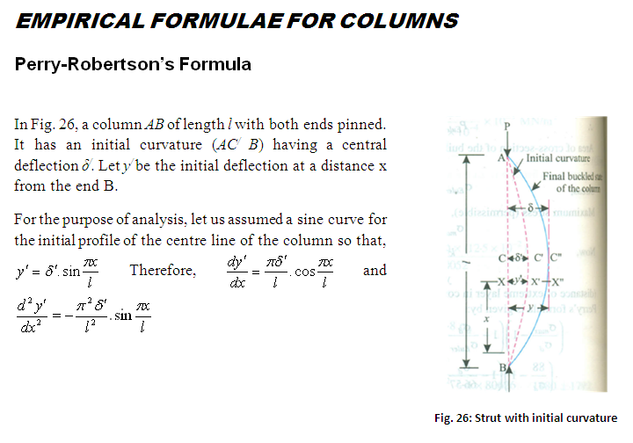

Slide 31
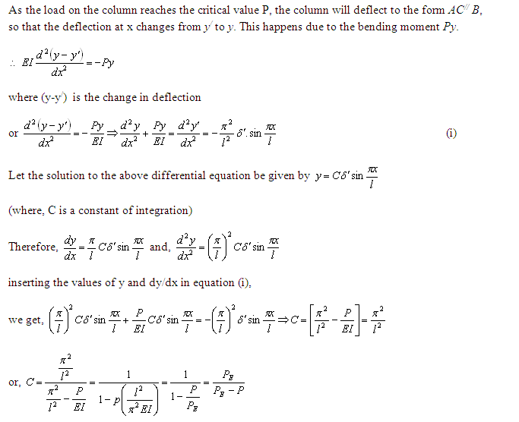

Slide 32
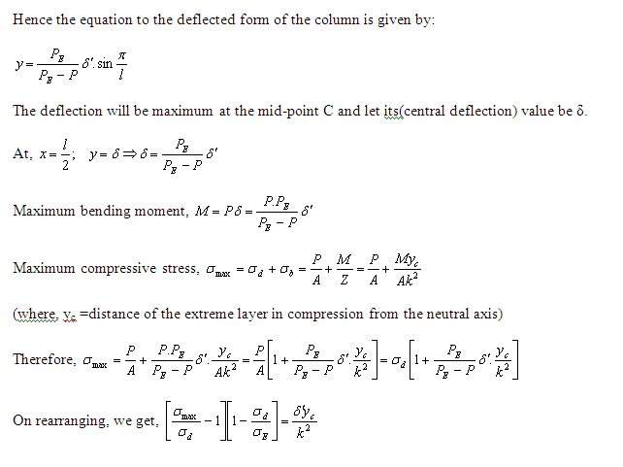

Slide 33
Example 7:
A steel strut has an outside diameter of 180mm and inside diameter of 120mm and is 6m long. It is hinged at both ends and is initially bent. Assuming the centre line of the strut as sinusoidal with maximum deviation of 9mm, determine the maximum stress developed due to an axial load of 150kN.take E=208 GPa

Slide 34
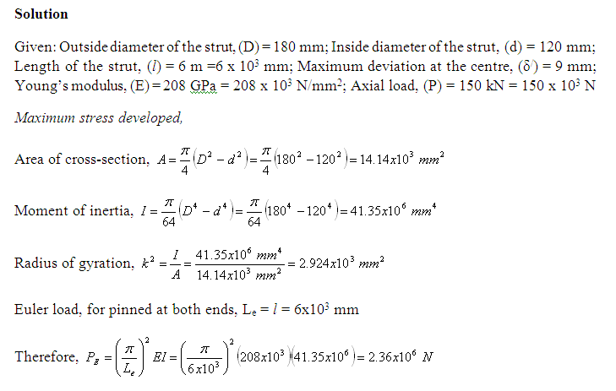

Slide 35
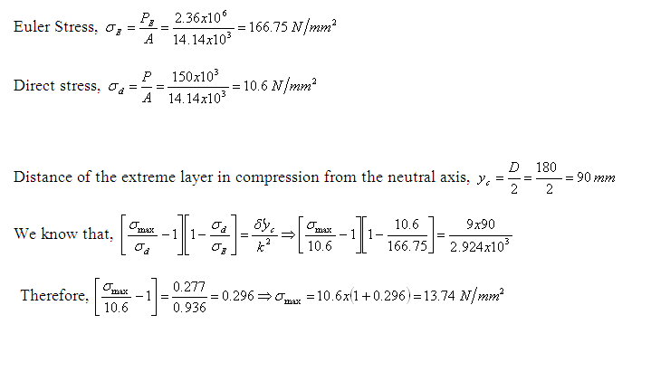

Slide 36
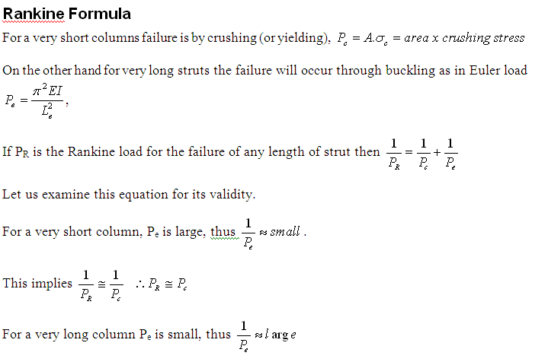

Slide 37
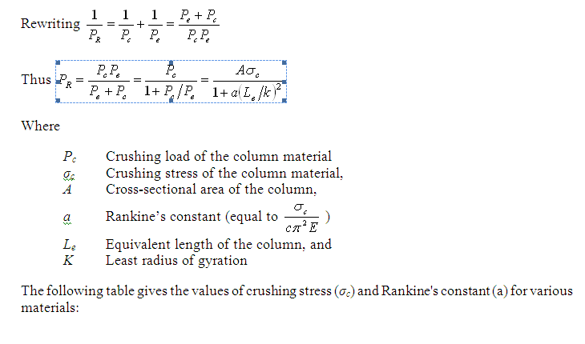

Slide 38
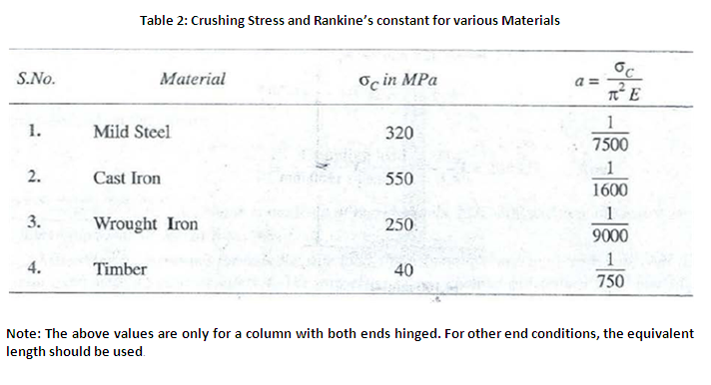

Slide 39
Example 8.
Find the Euler's crippling load for a hollow cylindrical steel column of 38 mm external diameter and 2.5 mm thick. Take length of the column as 2.3 m and hinged at its both ends. Take E = 205 GPa. Also determine crippling load by Rankine's formula using constants as 335 MPa and 1/7500

Slide 40
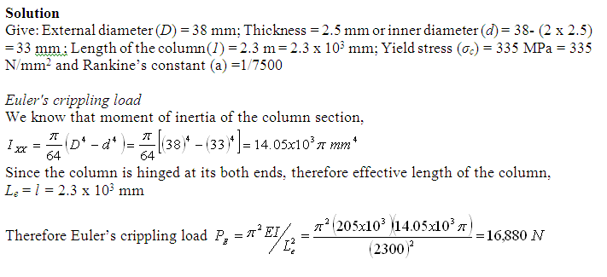

Slide 41
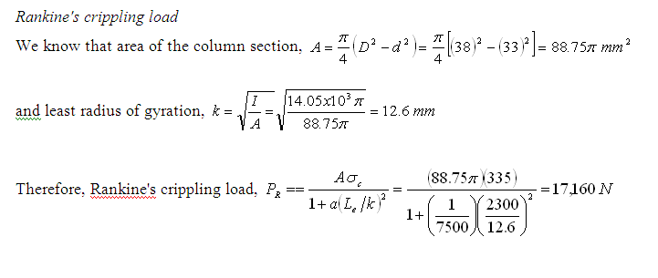

Slide 42
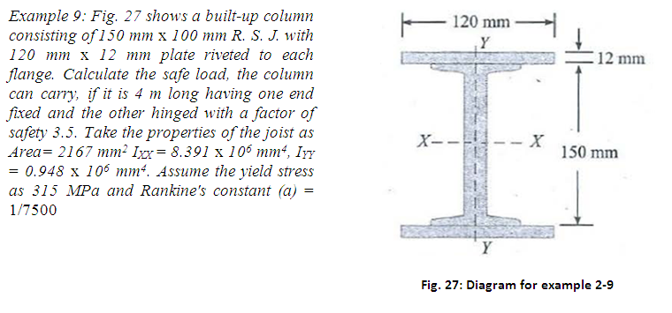

Slide 43
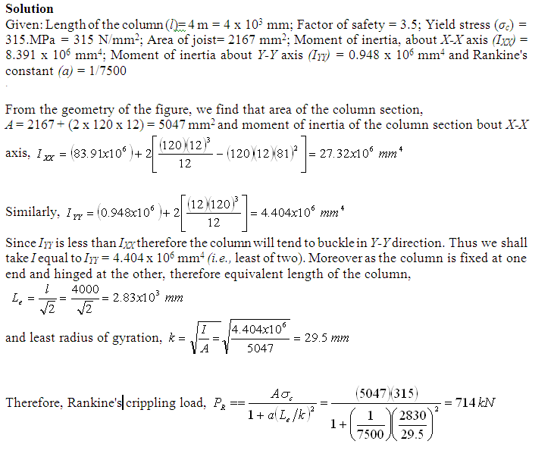

Slide 44
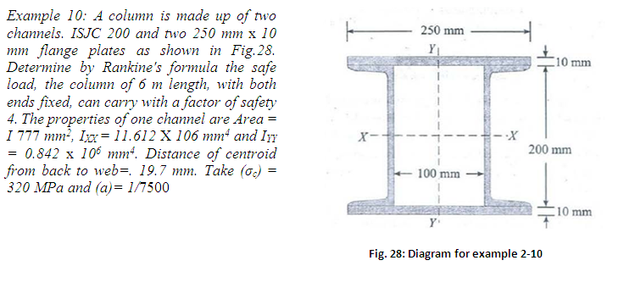

Slide 45
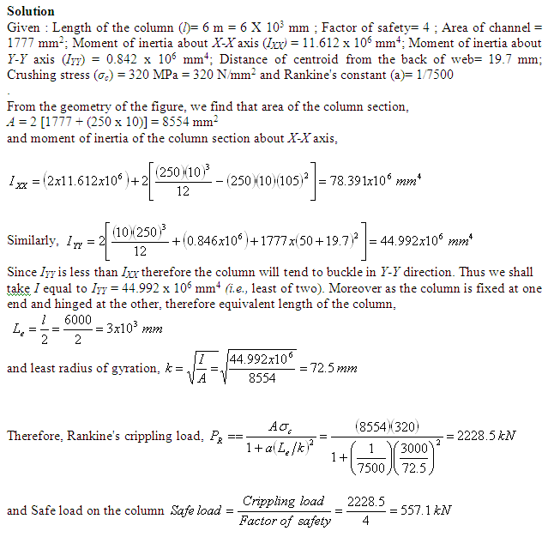

Slide 46
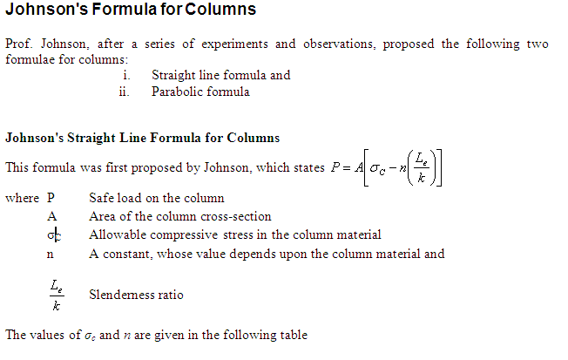
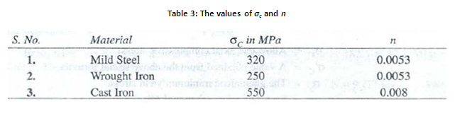

Slide 47
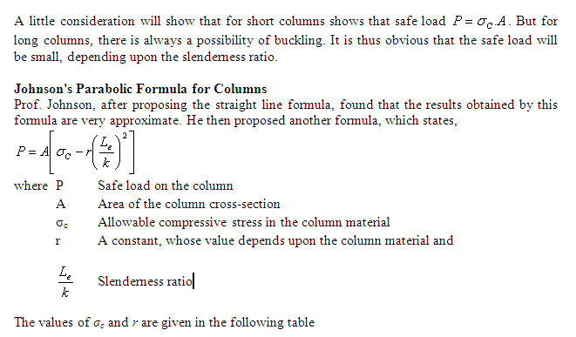

Slide 48
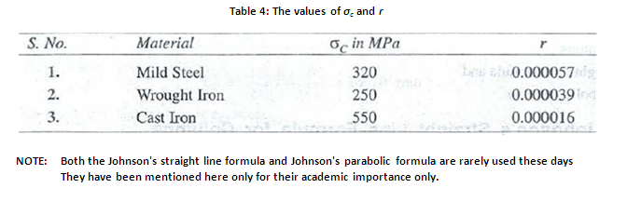

Slide 49
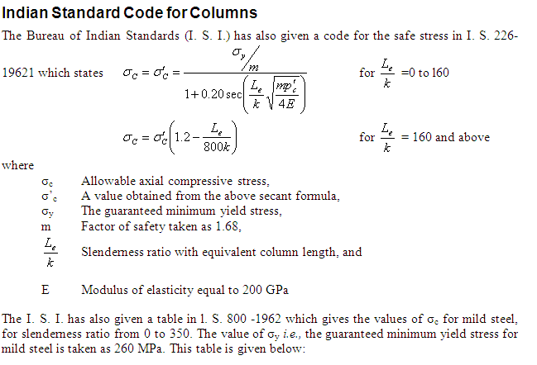

Slide 50
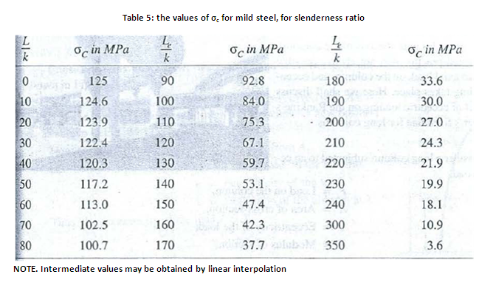

Slide 51
Example 11:
A hollow cylindrical steel tube of 38 mm external diameter and 2.5 mm thick is used as a column of 2.3 m. long with both ends hinged. Determine the safe load by I. S. code.

Slide 52
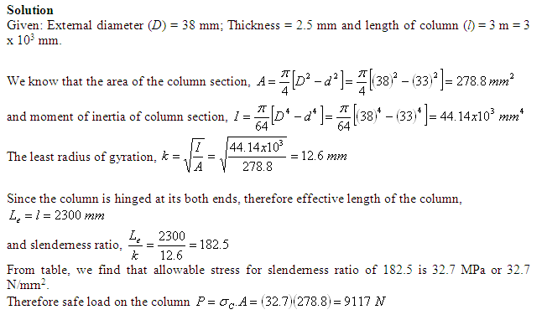

Slide 53
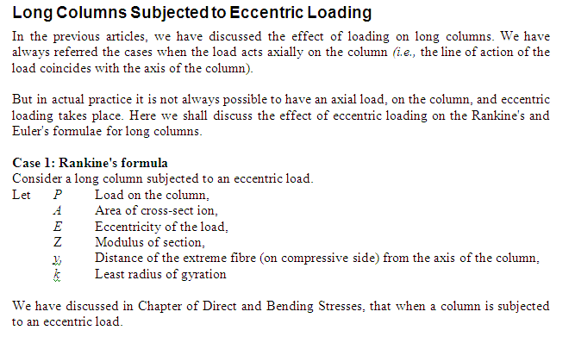

Slide 54
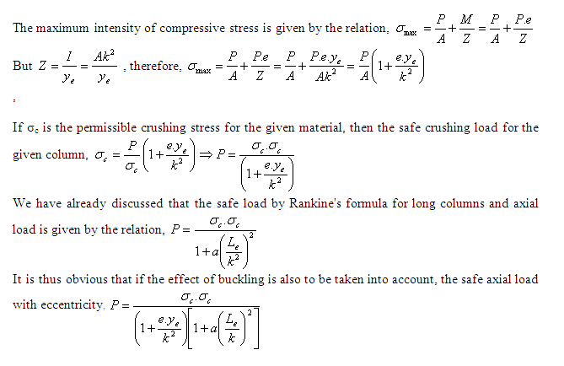

Slide 55
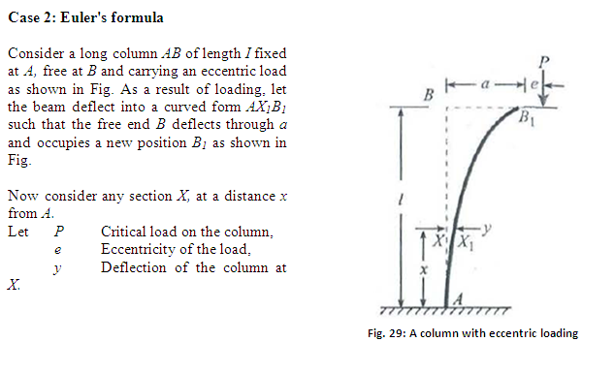

Slide 56
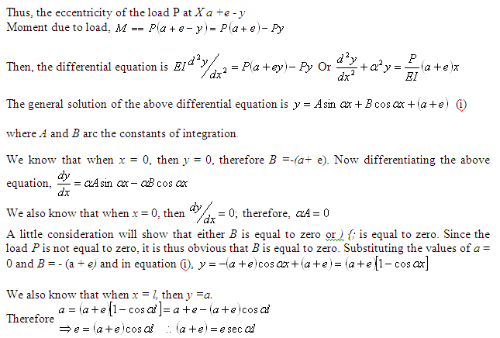

Slide 57
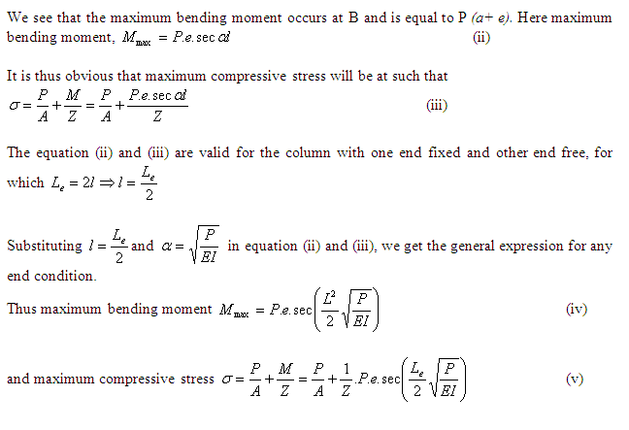

Slide 58
Example 12:
An alloy hollow circular column of 200 mm external and 160 mm internal diameter is 5 m long and fixed at both of its ends. It is subjected to a load of 120 kN at an eccentricity of 20 mm from the geometrical axis. Determine the maximum stress induced in the column section. Take E as 120 GPa.

Slide 59
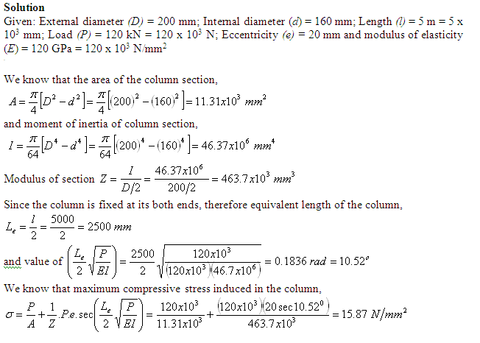

Slide 60
Self Assessment
Derive the Rankine formula and state its validity for small short columns

Slide 61
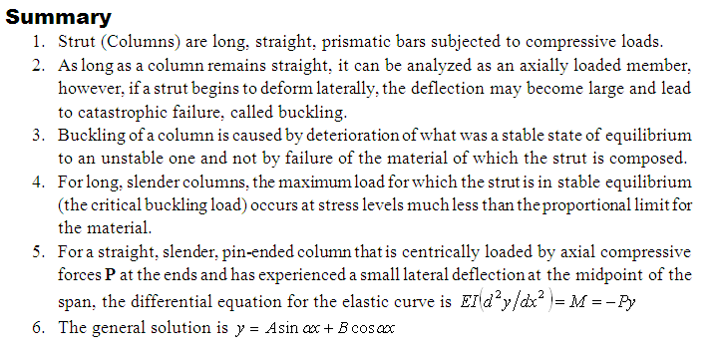

Slide 62
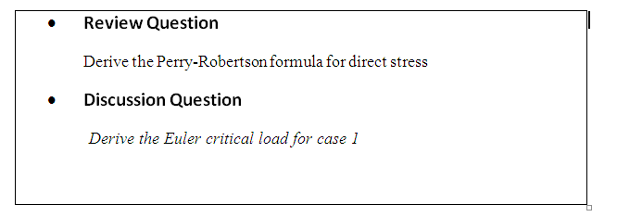

Slide 63
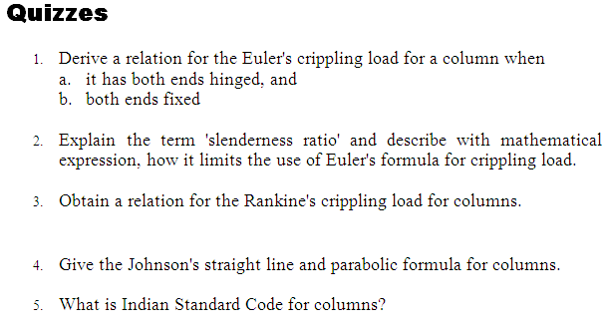

Slide 64
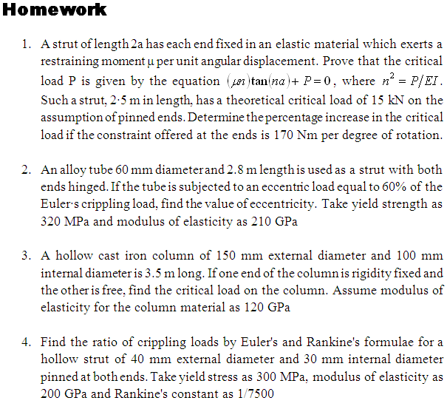

Slide 65
